Slide 1
Introduction
Instructor: Yao-Ting Huang
Bioinformatics Laboratory,
Department of Computer Science & Information Engineering,
National Chung Cheng University.

Slide 2
Lecture Information
Please check Ecourse2 regularly.
https://ecourse2.ccu.edu.tw
Email
ythuang@cs.ccu.edu.tw
Office hours
By email appointment

Slide 3
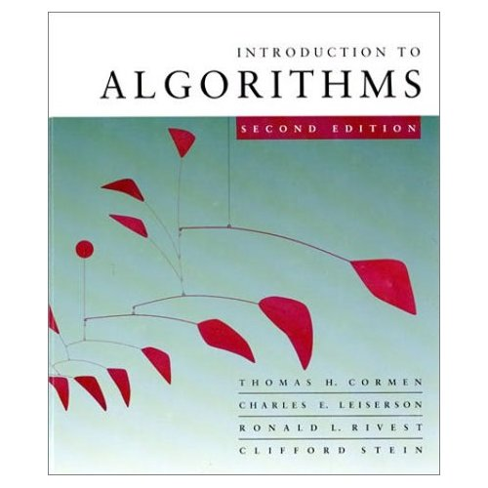
Text Book
Introduction to Algorithms, third edition.

Slide 4
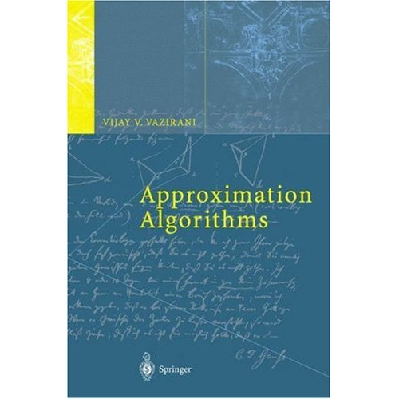
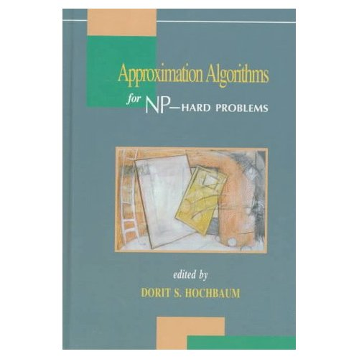
Reference Books
Approximation Algorithms, Springer-Verlag, Berlin, 2001.
Approximation Algorithms for NP-Hard Problems, 1996.

Slide 5
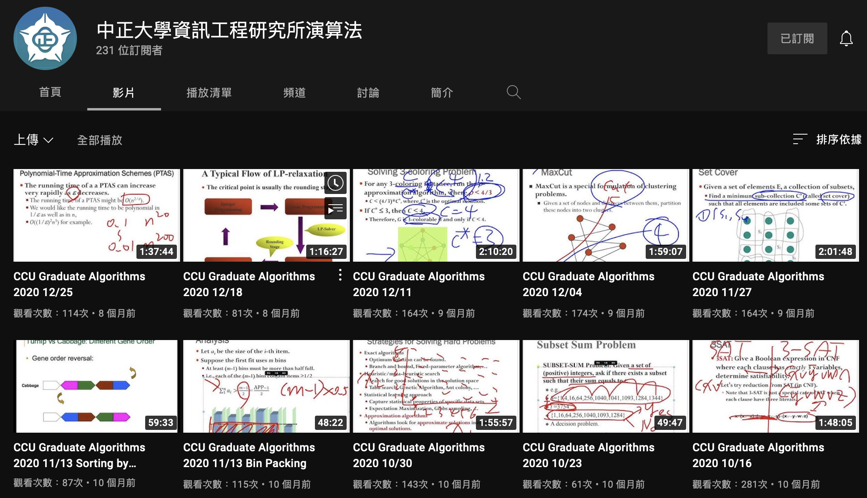
Online Resources
Youtube videos
https://www.youtube.com/channel/UCSbXgek9Di41-pnwU4Lkb5A
Notes:
https://www.facebook.com/bangye.wu/posts/10155286037578241

Slide 6
Problems and Algorithms
In the graduate school, you are asked to solve problems in different fields.
Even when implementing a large system, there is always core issues requiring theoretical analysis.
An algorithm is a set of ordered rules for solving a problem.
Traditionally, an algorithm should be accompanied with mathematical proofs (time/space/solution).
However, the term algorithm is now ambiguously referred to any idea.

Slide 7


Impact of LLM on Algorithms
With the advance of generative AI, do we still need to learn the all algorithms?
e.g., sorting algorithms, graph algorithms, string comparison, dynamic programming, …

Slide 8
Impact of Generative AI on Algorithms
The current GPT-4o can solves 50% of problems in homework and quizes of this lecture.
This includes formal proof of some algorithms.
Time complexity analysis of algorithms.
Correct implementation of the algorithms.
However, for complex problems, algorithms, and coding, current GPT is still limited.
Wrong answers or proofs to hard problems.
95% of its implementation is correct but still buggy.
You have to understand every line of code to debug.

Slide 9
Hardware and Software Improvement
In practical app, efficiency is affected by hardware and software.
Hardware
Message Passing Interface (MPI)
Multithreading programming (OpenMP)
Vector programming (SIMD)
Cache miss rate
CUDA
Cloud computing
Software
Data structure
Algorithm

Slide 10
OpenMP
OpenMP (Open Multi-Processing) supports shared memory multiprocessing programming, mostly via compiler directives.
int main()
{
#pragma omp parallel sections
{
#pragma omp section
{
for( int k = 0; k < 100; ++k ) {
printf(“Hello”);
}
}
#pragma omp section
{
for( int i = 0; i < 50; ++i ) {
printf(“World”);
}
}
}
}
int main() {
const int size = 256;
double Table[size];
#pragma omp parallel for
for(int n=0; n<size; ++n)
Table[n] = 2*n;
}

Slide 11
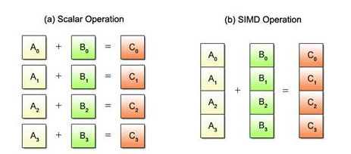
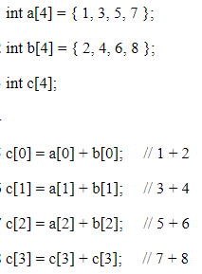
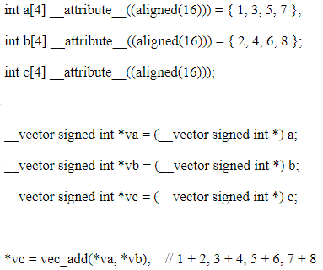
SIMD (Vector) Programming
https://mirrors.edge.kernel.org/pub/linux/kernel/people/geoff/cell/ps3-linux-docs/CellProgrammingTutorial/BasicsOfSIMDProgramming.html

Slide 12
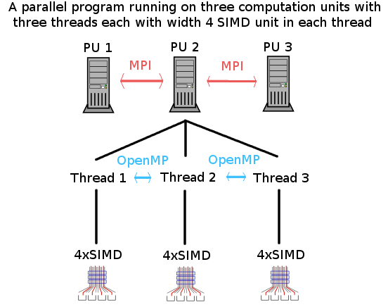
Real World
Multiple technologies are integrated for best performance.
http://sci.tuomastonteri.fi/programming/sse

Slide 13
Array vs Linked List
Access each element in an array v.s. linked list
Which one is faster during sequential access?
Array
1 | 2 | 3 | 4 | 5 | 6 | 7 | …
Linked list
1
2
3
4
5
6
7

Slide 14
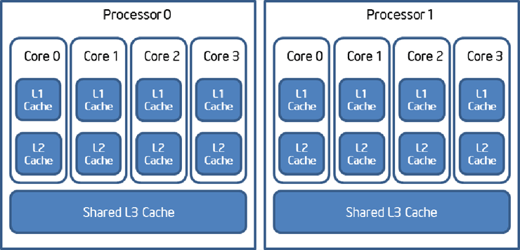
Cache Miss Reduces Speed
RAM is way too slow compared with cache.
Sequential access in an array (cache hit) is faster than random access in a list, tree, or graph.
https://software.intel.com/sites/default/files/m/d/4/1/d/8/device-fission-figure-1.gif

Slide 15
Hardware and Software Improvement
In practical app, efficiency is improved by both hardware and software.
Hardware
Message Passing Interface (MPI)
Multithreading programming (OpenMP)
Vector programming (SIMD)
Cache miss rate
CUDA
Cloud computing
Software
Data structure
Algorithm

Slide 16
Complexity (Big O Notations)
Hash function: O(1)
Binary search: O(log n)
The i-th largest element: O(n)
Merge sort: O(n log n)
Insertion sort: O(n²)
…
Recursive Fibnacci: O(1.5^{n})

Slide 17
Practical Complexity

Slide 18
Exponential Growth
This is often due to the following reasons:
Your program is not well written.
The problem is in fact really hard.
You need to learn different techniques for solving these problems.
int fib (int n){
if(n == 0 || n == 1)
return n;
else
return ( fib (n-1) + fib (n-2) );
}

Slide 19
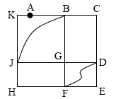
Easy and Hard Problems
e.g., Euler Tour v.s. Hamiltonian cycle.

Slide 20
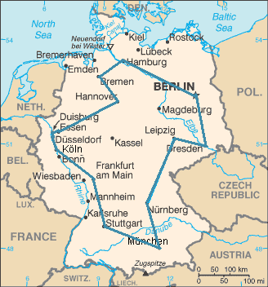
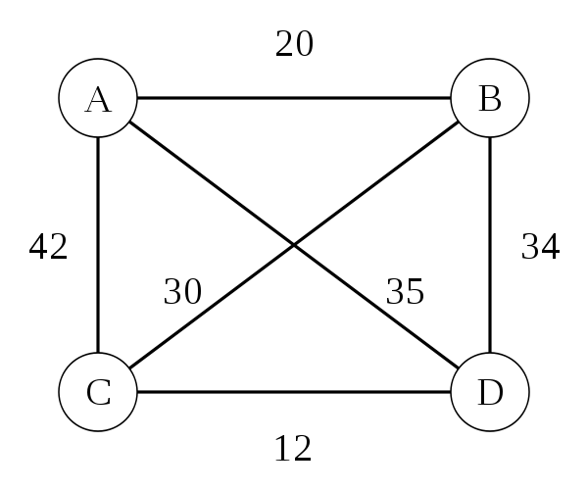
Traveling Salesman Problem (TSP)
A complete graph with cost c(i, j) to go from city i to city j.
A salesman must travel to n cities, visiting each city exactly once and finishing where he begins with minimized travel cost.

Slide 21
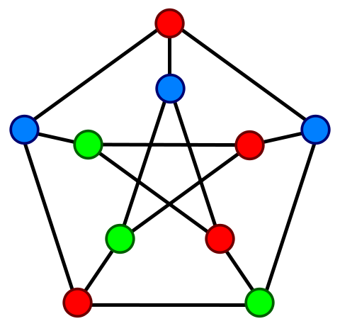
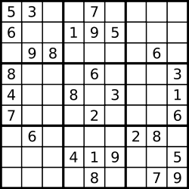
Graph Coloring Problem
The k-coloring problem aims to color the vertices of a graph using k colors such that no two adjacent vertices have the same color.
Is k-color in NP?

Slide 22
Satisfiability (SAT) Problem
The SAT problem is to determine whether a boolean expression is satisfiable.
Is SAT problem in NP?
Someone claimed he got a solution satisfying the following boolean expression.
It is easy to verify if his solution indeed satisfies.

Slide 23
Syllabus
Asymptotic analysis, divide and conquer
Polynomial-time solvable problems
Dynamic programming, string index, graph problems.
P, NP, NP-completeness
Proof of NPC by reduction
Approximation algorithms
Deterministic/randomized approaches
Relaxation techniques
Inapproximability
Polynomial-time approximation scheme
Fixed-parameter algorithm

Slide 24
Grading Policies (16+2)
Two quizzes: 20%
Two homework: 30%, 15% each.
Midterm exam: 35%
Final exam: 35%
Lecture Q&A: 10%
Ecourse Q&A: 10%
Only meaningful questions and answers get bonus.
TA will determine the if the Q&A is meningful.

Slide 25
Conclusion
You can watch videos by yourself.
https://www.youtube.com/channel/UCSbXgek9Di41-pnwU4Lkb5A
Please check E-course2 regularly.
https://ecourse2.ccu.edu.tw

